Slide 1
MA4605
Question 3

Slide 2
Question 3a
Coefficients Std Error t Stat P-value
Intercept 0.002107 0.004787 0.440144 0.678209
Conc 0.025164 0.000266 94.76047 2.48E-09
Intercept and Slope estimates in bold.

Slide 3
Question 3b
95% confidence interval for slope
Estimate ot Slope = 0.025164
Std. Error for slope = 0.000266 from table
Quantiles (given) = -2.57 for Lower
= 2.57 for Upper
Lower bound = 0.025164 + (-2.57)( 0.000266)
= 0.0243
`
Upper bound = 0.025164 + (2.57)( 0.000266)
= 0.0257
Confidence Interval = [0.0243, 0.0257]

Slide 4
Question 3b
95% confidence interval for intercept
Estimate of intercept = 0.002107
Std. Error for intercept = 0.004787
Same calculation as previous
Confidence Interval = [-0.0102, 0.0144]

Slide 5

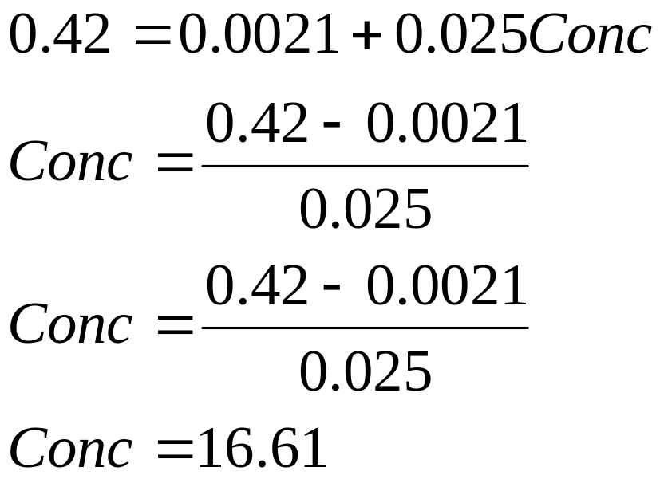
Question 3c

Slide 6
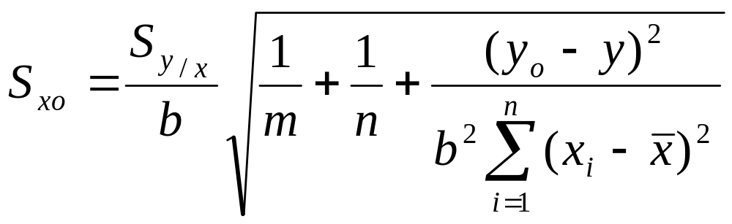
Question 3d
Refer to formulae for explanation of terms

Slide 7
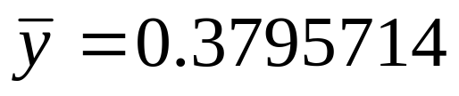

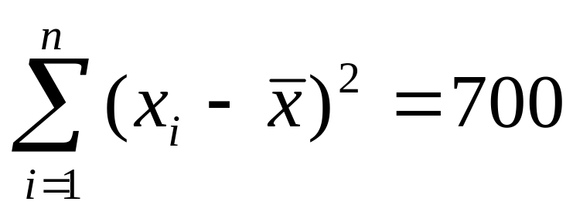
Question 3c
Number of test values m=1
calibration sample size n=7
slope estimate b=0.025
mean absorbance
mean concentration

Slide 8
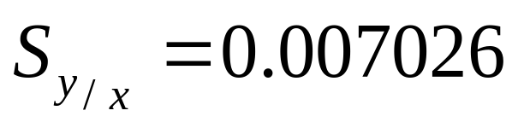
Question 3d
Residual Std. Error
Test value y₀ = 0.42
Using the formula given
Std. Error = 0.2989641

Slide 9
Question 3d
With the standard error determined we can calculate the confidence intervals in the same way as previous parts
Estimate = 16.61
Quantile = -2.57 / 2.57
Estimate + ( quantile ×std.error)
Ans: [15.84, 17.38]

Slide 10
Question 3f
Response to blank signal
Estimate for absorbance when conc=0
This is given by the Intercept estimate (a)
y(B) =a = 0.0021
Response standard Error
from data output
S(y/x) = 0.007026
Limit of detection
a + 3 S(y/x) = 0.0021+3(0.007026) = 0.0232

